Slide 1

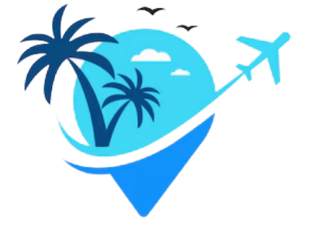
WANDERLUST – A PERSONALIZED TRAVEL PLANNING AND TRACKING APP
Wanderlust is a smart, user-friendly travel app designed to simplify and enhance the travel planning experience. The app offers personalized travel suggestions, real-time tracking, and an intuitive itinerary organizer to create unforgettable trips. With AI-powered recommendations based on users' preferences, budget, and past trips, Wanderlust serves as a one-stop solution for all travel needs, from exploring new destinations to managing logistics.

Slide 2

DESCRIPTION
· Personalized Recommendations & Dynamic Content: Wanderlust’s AI-driven engine learns from user preferences, travel history, and budget to curate relevant suggestions for destinations, accommodations, activities, and dining options. Users receive tailored itineraries that can be adjusted on the fly, ensuring flexibility and spontaneity during the trip.
· Smart Itinerary Management: The app organizes and visualizes each part of the journey, including flights, accommodations, activities, and meals, so users have a clear day-to-day plan. It also integrates with third-party services for bookings, maps, and local guides, making it a centralized hub for all travel-related data.
· Real-Time Tracking and Instant Updates: Wanderlust features GPS tracking and live location sharing for added safety and convenience, helping travelers navigate unfamiliar places with ease. It also provides real-time updates on flight status, local weather, and traffic, helping users adjust plans on the go.
· Expense Tracking & Budgeting Tools: Wanderlust includes expense tracking, allowing users to input and categorize travel expenses to stay within budget. With real-time currency conversion and a budget breakdown by category (e.g., food, lodging, transport), users have better control over their finances.
· Customizable Alerts and Reminders: Users receive automated alerts and reminders for essential travel tasks like passport renewals, check-in times, hotel reservations, and flight boarding. This feature helps travelers stay organized, especially when juggling multiple reservations and connections.

Slide 3
MAIN ACTIVITY .KT
import android.content.Context
import android.content.Intent
import android.os.Bundle
import androidx.activity.ComponentActivity
import androidx.activity.compose.setContent
import androidx.compose.foundation.Image
import androidx.compose.foundation.clickable
import androidx.compose.foundation.layout.*
import androidx.compose.foundation.rememberScrollState
import androidx.compose.foundation.verticalScroll
import androidx.compose.material.Card
import androidx.compose.runtime.Composable
import androidx.compose.ui.Alignment
import androidx.compose.ui.Modifier

Slide 4
import androidx.compose.ui.draw.scale
import androidx.compose.ui.graphics.Color
import androidx.compose.ui.res.painterResource
import androidx.compose.ui.res.stringResource
import androidx.compose.ui.text.font.FontFamily
import androidx.compose.ui.text.font.FontWeight
import androidx.compose.ui.text.style.TextAlign
import androidx.compose.ui.unit.dp
import androidx.compose.ui.unit.sp
class MainActivity : ComponentActivity() {
override fun onCreate(savedInstanceState: Bundle?) {
super.onCreate(savedInstanceState)
setContent {
TravelApp(this)
}
}

Slide 5
@Composable
fun TravelApp(context: Context) {
Column(
modifier = Modifier
.padding(20.dp)
.verticalScroll(rememberScrollState())
) {
Text(
fontSize = 40.sp,
color = Color(android.graphics.Color.rgb(120, 40, 251)),
fontFamily = FontFamily.Cursive,
text = "Wanderlust Travel"
)
Spacer(modifier = Modifier.height(20.dp))

Slide 6
// 01
Card(
modifier = Modifier
.fillMaxWidth()
.height(250.dp)
.clickable {
context.startActivity(
Intent(context, BaliActivity::class.java)
)
},
elevation = 8.dp
{
Column(
horizontalAlignment = Alignment.CenterHorizontally
) {
Image(
painterResource(id = R.drawable.bali), contentDescription = "",
modifier = Modifier

Slide 7
.height(150.dp)
.scale(scaleX = 1.2F, scaleY = 1F)
)
Text(
text = stringResource(id = R.string.place_1),
fontSize = 18.sp
)
Text(
text = stringResource(id = R.string.description),
fontWeight = FontWeight.Light,
fontSize = 16.sp,
textAlign = TextAlign.Center,
)

Slide 8
Text(
text = stringResource(id = R.string.plan), color = Color.Gray,
fontSize = 16.sp
)
}
}
Spacer(modifier = Modifier.height(20.dp))
//02
Card(
modifier = Modifier
.fillMaxWidth()

Slide 9
.height(250.dp)
.clickable {
context.startActivity(
Intent(context, ParisActivity::class.java)
)
},
elevation = 8.dp
)
{
Column(
horizontalAlignment = Alignment.CenterHorizontally
) {
Image(
painterResource(id = R.drawable.paris), contentDescription = "",
modifier = Modifier
.height(150.dp)
.scale(scaleX = 1.2F, scaleY = 1F)

Slide 10
Text(
text = stringResource(id = R.string.place_2),
fontSize = 18.sp
)
Text(
text = stringResource(id = R.string.description),
fontWeight = FontWeight.Light,
fontSize = 16.sp,
textAlign = TextAlign.Center,
)
Text(
text = stringResource(id = R.string.plan), color = Color.Gray,
fontSize = 16.sp
)
}
}

Slide 11
Spacer(modifier = Modifier.height(20.dp)) //03
Card(
modifier = Modifier
.fillMaxWidth()
.height(250.dp)
.clickable {
context.startActivity(
Intent(context, SingaporeActivity::class.java)
)
},
elevation = 8.dp
)
{
Column(
horizontalAlignment = Alignment.CenterHorizontally
) {

Slide 12
Image(
painterResource(id = R.drawable.singapore), contentDescription = "",
modifier = Modifier
.height(150.dp)
.scale(scaleX = 1.2F, scaleY = 1F)
)
Text(
text = stringResource(id = R.string.place_3),
fontSize = 18.sp
) Text(
text = stringResource(id = R.string.description),
fontWeight = FontWeight.Light,
fontSize = 16.sp,
textAlign = TextAlign.Center,
)

Slide 13
Text(
text = stringResource(id = R.string.plan), color = Color.Gray,
fontSize = 16.sp
)
}
}
Spacer(modifier = Modifier.height(20.dp))
}
}
}

Slide 14
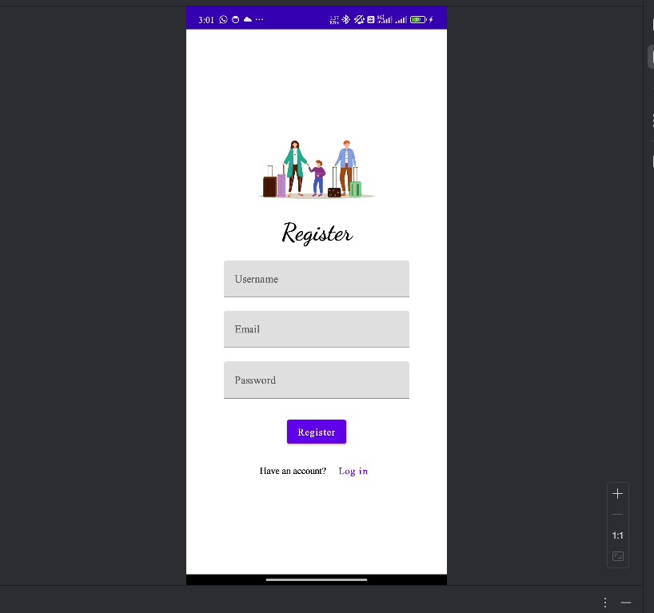

Slide 15
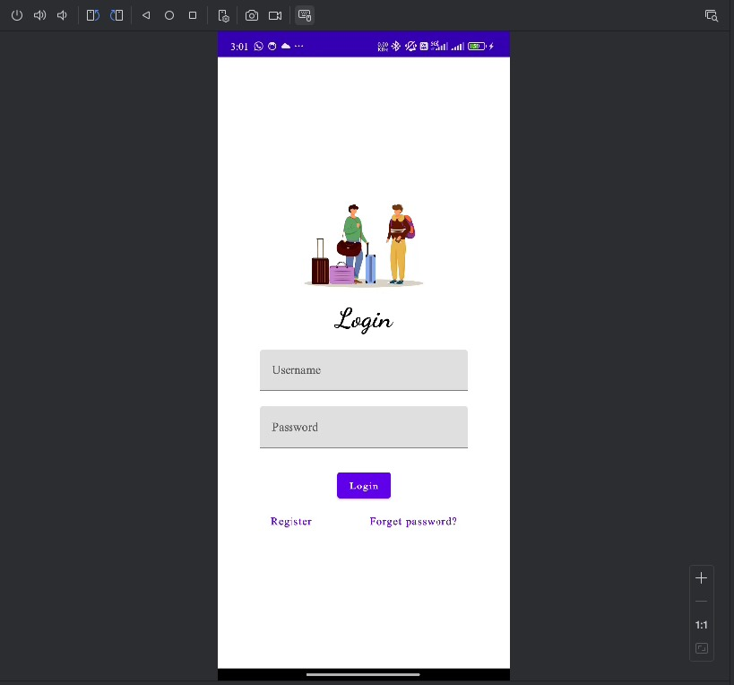

Slide 16
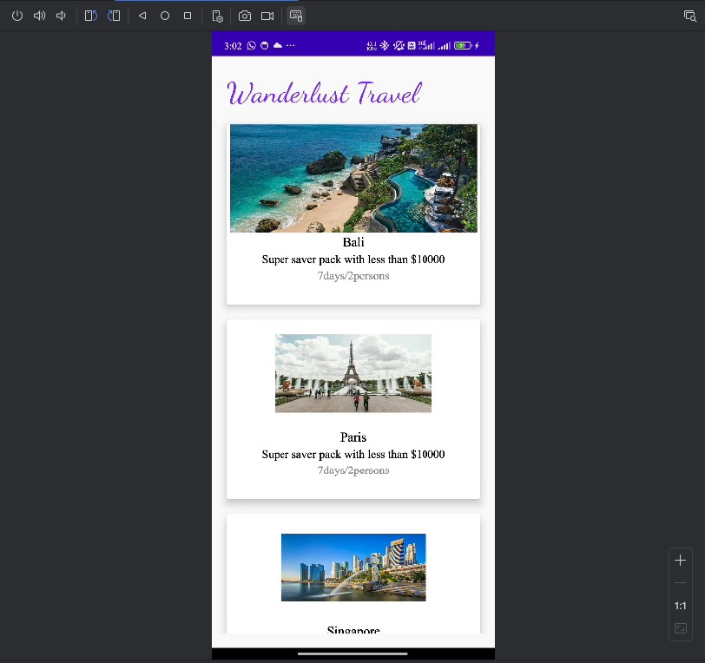

Slide 17
